Slide 1
Customer Analysis Project
File created on: 12/30/2023 4:00:52 PM

Slide 2
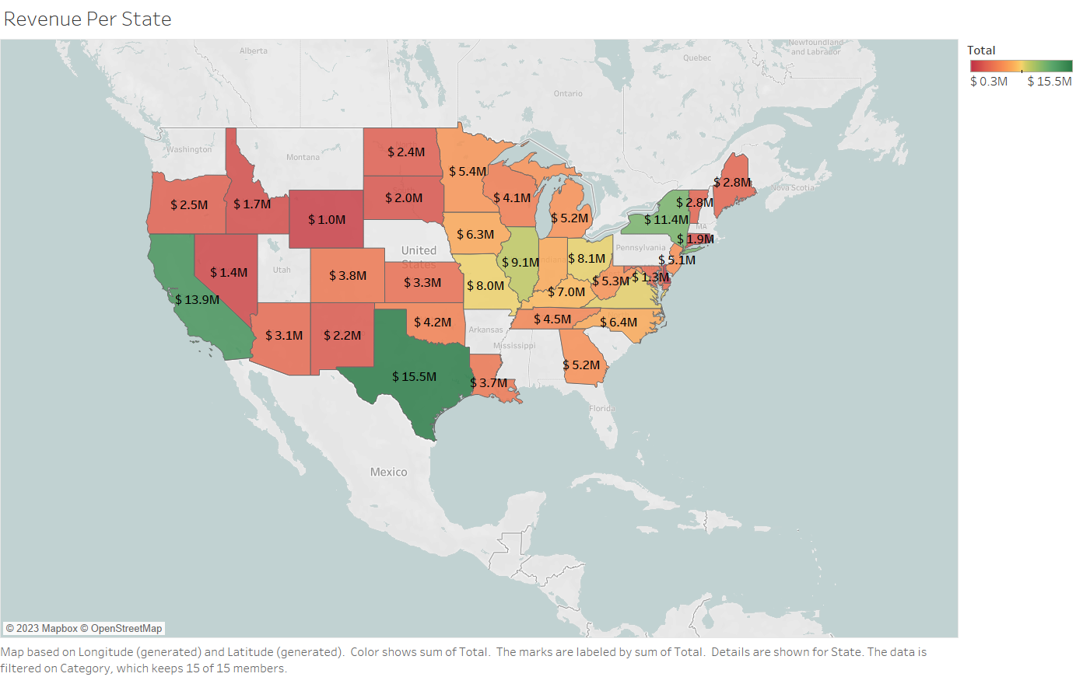

Slide 3
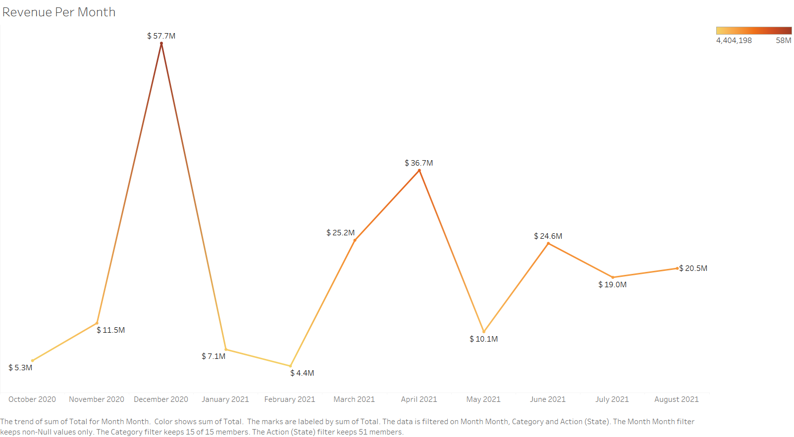

Slide 4


Slide 5
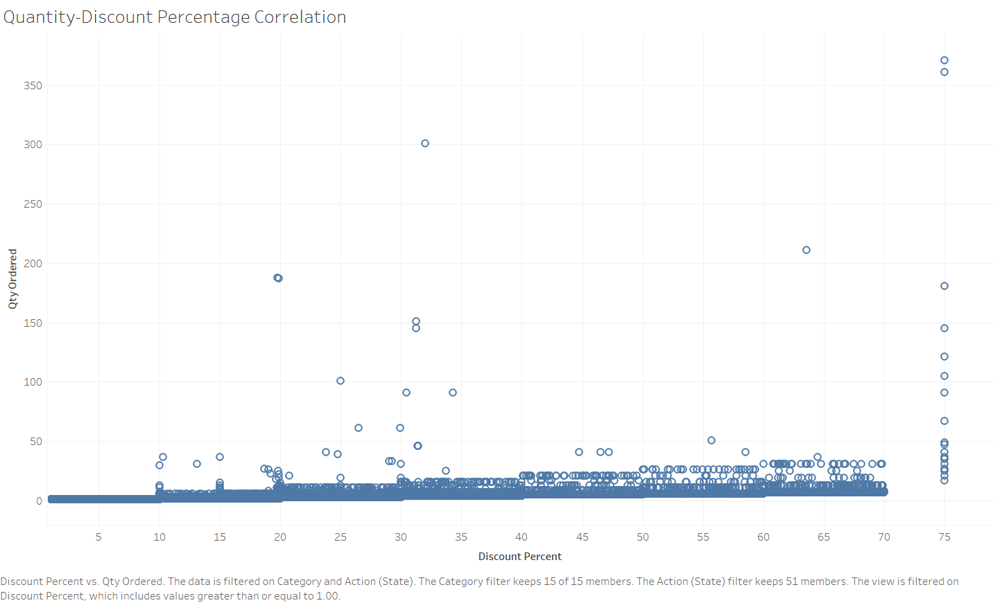

Slide 6
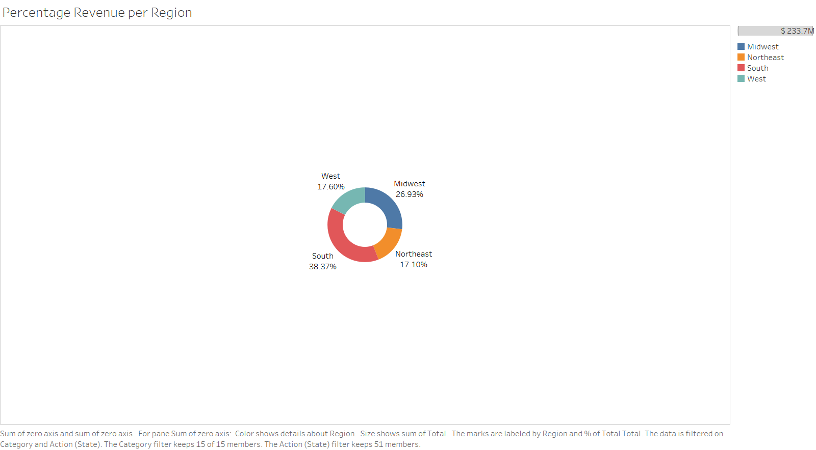

Slide 7


Slide 8
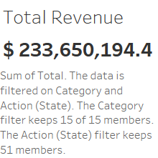

Slide 9
